Slide 1

RETIRALS
EXIT ORIENTATION SESSION

Slide 2

PROVIDENT FUND
UAN & BENEFITS
GRATUITY FUND
ELIGIBILITY & THE PROCESS FOR GRATUITY FUND
TRACKING OF CLAIMS
UAN ACTIVATION
E-NOMINATION UNDER UAN PROFILE
ONLINE CLAIM SERVICES
FAQs & CONTACT DETAILS
KYC PROCESS
HOW TO CHECK PF BALANCE

Slide 3
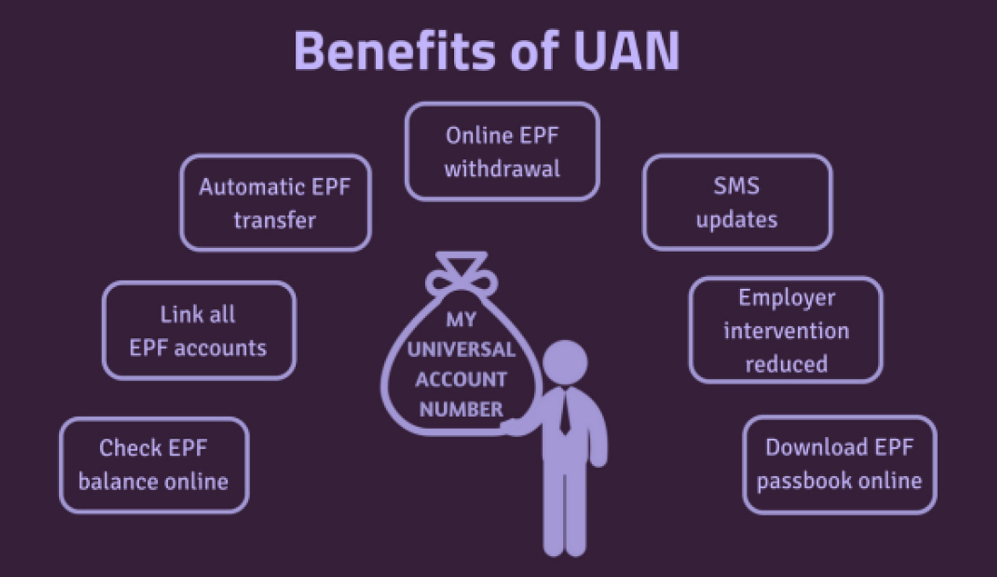
UAN – MEANING & BENEFITS
MEANING OF UAN:
UAN stands for Universal Account Number.
The EPFO allots a 12 Digit UAN to every Provident Fund Member.

Slide 4
ACTIVATION OF UAN
1
Visit UAN based Member Portal
2
3
4
Member will be directed to next page , where Member needs to enter UAN, Aadhaar Card no., Name, Date of Birth, Mobile No. & the Captcha
Click on the checkbox provided on the screen & then on ‘Get Authorization Pin’, accordingly Pin will be sent to the given Mobile Number of the Member. Enter the Pin &validate it.
Click on ‘Activate UAN’ Button. Accordingly, UAN will be activated, Member will receive a password on registered mobile number which will be used for accessing your UAN account.
Click on “Activate UAN” under Important Links
*Notes:
Link for UAN based Member Portal: https://unifiedportal-mem.epfindia.gov.in/memberinterface/
The following information being entered should be as per EPFO records:
UAN of member , Member's Aadhaar number, Name, Date of birth should be as available in EPFO records.
Member should have a valid mobile linked with Aadhaar number as per UIDAI records.
Member's Aadhaar number, Name, Date of birth should be same as member's Aadhaar details.

Slide 5
KYC UNDER UAN PROFILE
1
2
3
Click on ‘MANAGE’ & Select “KYC” option
Click on KYC document to Add
Enter details & Click on the checkbox to save the KYC
*Notes:
Aadhaar Card, PAN Card and Bank Account details are Mandatory documents required for completing the KYC process.
A Member should enter the document number, and additional details such as IFSC in case of bank details and expiry date in case of passport
The KYC details should be approved digitally by the Employer.
In case you do not want your details to be updated, you can cancel the KYC process by clicking on the “X” sign marked against the document before it is approved or verified by the Employer.

Slide 6
E-Nomination
The Employees’ Provident Fund Organization (EPFO) has been constantly enhancing the digitization framework with the ultimate goal of paying out Provident Fund (PF) and Pension (EPS) claims in a timely manner post retirement to subscribers or to their nominees on a member’s demise. Towards this, the processes have been made simple, transparent and technology driven.
Nomination helps Nominees to access social security benefits (such as PF, Pension & EDLI) online. It also helps speedy Pension claim settlements for Members.
Login to UAN Profile
Click on ‘Manage’ & Select ‘E-Nomination’
Enter Address Details
Add Family Details
Authorise nomination details through “E-Sign”
Declare share amount & Save the details
*Notes:
The e-Nomination facility can be availed only by members who have an active UAN and active mobile number linked and verified with Aadhaar.
Also, all your personal details such as address, mobile number must be available on the Member Portal. You can check your personal details under the 'Profile’ tab.
The photograph of an EPF member along with his/her Nominee should be available under UAN profile. In case the photographs are not available then it can be uploaded through Profile section.
Photograph size should be 3.5 cmx 4.5 cm
The image should be in jpeg or jpg or png format

Slide 7
PF BALANCE
Methods to check PF balances
1
2
3
4
Umang app:
The Umang app allows users to see their EPF Passbook, submit claims, and track their claims through mobile phones. To get started, enter your UAN- registered mobile number and complete one-time registration.
EPFO Portal:
You must go to https://passbook.epfindia.gov.in/MemberPassBook/Loginand. Enter your UAN and password to check your balance.
SMS facility:
To check the balance of your EPF account, send an SMS to 7738299899. EPFOHO UAN is the format in which the message must be sent. To get this message in a language other than English, include the first three characters of the desired language in the message.
Missed call facility:
By initiating a missed call to 011-22901406 an EPFO member can check the balance of their EPF account. In order to use this service, a member must have Universal Account Number (UAN). This service is provided without charge.
Note:
The PF Passbook on the EPFO Portal can be accessible if:
UAN is activated & linked with the Mobile no. registered under Aadhaar Profile.
Aadhaar seeding has been completed under UAN Profile.
E-Nomination has been submitted & it is approved through e-sign.

Slide 8

PROCESS DOCUMENTS - PROVIDENT FUND
PF TRANSFER PROCESS- An Employee need to raise PF Transfer request, once existing UAN is mapped to new PF Account no. at New Employer
PF WITHDRAWAL PROCESS- Provident Fund helps employees build a corpus for their retirement. It is Social Security Measures initiated by the Govt. of India with an objective of providing benefits to its member at the time of retirement, The Members would be allowed to withdraw their Provident Fund in below cases
Resignation (If unemployed after Two months from the separation date)
Retirement
Permanent Disability of Employee
An employee can submit PF Withdrawal Application on the UAN based Member Portal after completion of 2 Months period after leaving the job.
Notes:
Link for UAN based Member Portal: https://unifiedportal-mem.epfindia.gov.in/memberinterface/
An employee need to ensure that all the mandatory KYC details such as Aadhaar, Bank Account No. & PAN details are linked to UAN & it is digitally approved by the Employer on UAN based Member Portal.

Slide 9

GRATUITY FUND (Eligibility criteria & process)
Eligibility Criteria for Gratuity Fund:
An employee who worked for 4 years and 240 days or more for India service period, will be eligible for gratuity.
Process to claim Gratuity Fund:
No Claim Form is required for Gratuity amount below 20 lacs
If your Gratuity amount is 20 lacs & above in lifetime, kindly provide Gratuity Declaration Form
Upon Validation of the record, the claim will be processed, and disbursement of the amount will be done in your Salary Bank Account updated under Payroll record
For onsite cases- pls share bank account details with Retirals Team at below mentioned mail ids:
Salvi, Yogesh <yogesh.salvi@capgemini.com>
Natarajan, Sendu <sendu.natarajan@capgemini.com>

Slide 10
PROVIDENT FUND - FAQ
EPFO Contact Details
Contact for Retirals Helpdesk
PF Withdrawal
PF Transfer Process
Mismatch in Aadhaar & UAN Profile details
Mandatory KYCs in PF
Aadhaar, PAN, Bank Account Details are mandatory KYCs which needs to be updated in EPFO Portal.
Please raise a ticket on retiralshelpdesk.in@capgemini.com through personal email id for further process or status of your JDC.
After generation of your new PF Member ID at new Employer, raise a Transfer request through UAN Profile, auto-transfer is not possible.
Helpdesk Number: 1800 118 005
Please raise a ticket on retiralshelpdesk.in@capgemini.com through personal email id for any queries related to Retirals.
Its mandatory to Transfer PF to new Organization. Exceptional cases:
employeefeedback@epfindia.gov.in
Raise a Grievance on https://epfigms.gov.in/
Retirement,
Un-employed for more than 2 months.
Permanent Disability of an Employee

Slide 11
GRATUITY FUND- FAQ
Gratuity Settlement Process
Track Gratuity Settlement Status
Timeline to process Gratuity Settlement
Document Required for Gratuity Settlement
Eligibility of Gratuity
An employee who worked for 4 years and 240 days or more, will be eligible for Gratuity.
We will process your gratuity without Form.
Gratuity claim is processed and disbursed within 30 days from your last working date.
Gratuity claim is processed separately and not along with the final settlement.
Raise a ticket on retiralshelpdesk.in@capgemini.com through personal email id in case Gratuity payment is not completed within 30 days from your date of exit.
It is processed only after your date of exit.

Slide 12
Contact details - RETIRALS
DL Retirals Team - retiralshelpdesk.in@capgemini.com – Pls. send email through personal email id
Please mention your GLOBAL ID & PF Member ID/UAN while communicating with RETIRALS team, it would be helpful for us to retrieve your data faster.
Responses turnaround time: 3 Business Days
Do not change subject line & request you to wait for the resolution in order to avoid reminders on the same query.

Slide 13

THANK YOU

Slide 14
GET THE FUTURE YOU WANT

